Slide 1
To the End of Our Days
Nurturing Life
in the Face of Death
Steven Bozza, MA, Director
Respect Life Office
Archdiocese of Philadelphia
Phone: (215) 587-5661
Email: sbozza@adphila.org
www.archphila.org

Slide 2
End of Life Issues
Euthanasia
Quality of Life
Pain Management
Nutrition and Hydration
Do Not Resuscitate Orders
Futile Care
Living Will

Slide 3
The Central Question
Are my
actions or inactions
causing death?

Slide 4
Euthanasia
Definition
An action or an omission which of itself or by intention causes death, in order that all suffering may in this way be eliminated

Slide 5
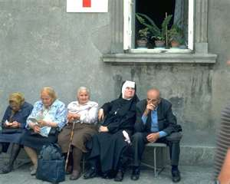
Quality of Life
Definition
The ability to participate in social life as far as one can; the the fulfillment of all one’s physical, psychological and spiritual potential.

Slide 6
Pain Management
Patients should be kept as free of pain as possible
Since a person has the right to prepare for his or her death while fully conscious, he or she should not be deprived of consciousness without a compelling reason.
Medicines capable of alleviating or suppressing pain may be given to a dying person, even if this therapy may indirectly shorten the person’s life so long as the intent is not to hasten death.

Slide 7
Nutrition and Hydration
Normal ordinary care not treatment
Without them, a person will die of starvation and/or dehydration

Slide 8
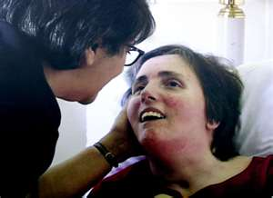
Nutrition and Hydration
Can be discontinued if:
Death is imminent – imminent meaning that death will occur within hours
The person’s body is not able to assimilate them
They cause significant physical discomfort to the patient

Slide 9
Do Not Resuscitate (DNR)
An order that, in the event of cardiac arrest sudden respiratory failure, no Cardio-Pulmonary Resuscitation (CPR) will be administered.
It can be placed if CPR will be of no significant benefit to the patient or be a significant burden to him or her

Slide 10
Do Not Resuscitate (DNR)
A DNR is not an order that calls on medical professionals to do nothing at all to a patient in a life threatening condition.
DNR Tattoo

Slide 11
Ordinary/Proportionate Care
Medication, therapy or surgery that offers reasonable hope of benefit and is not exotic, experimental or overly burdensome to the patient
Obligatory

Slide 12
Extraordinary/Disproportionate Care
Medication, therapy or surgery that does not offer reasonable hope of benefit or is exotic, experimental or overly burdensome to the patient
Not Obligatory

Slide 13
Medical Futility
When no medical intervention would be of benefit to the patient, and death is inevitable, treatment can be withheld and the patient allowed to die.

Slide 14
Advance Directives a.k.a. Living Wills
A living will is a written document which sets forth a person’s wishes and gives instructions about health care when the person has an end-stage medical condition, or is permanently unconscious.

Slide 15
Living Wills
Health care proxy must share your values
Communicate, communicate, communicate
Revisit the Living Will regularly
http://archphila.org/evangelization/resplife/prolife/livingwill.htm

